Slide 1
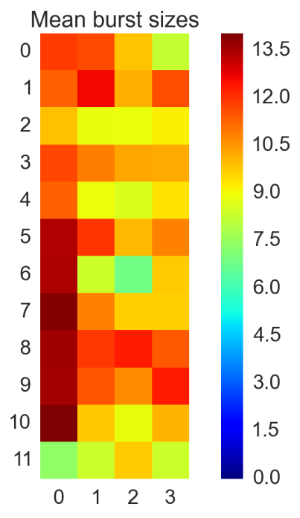
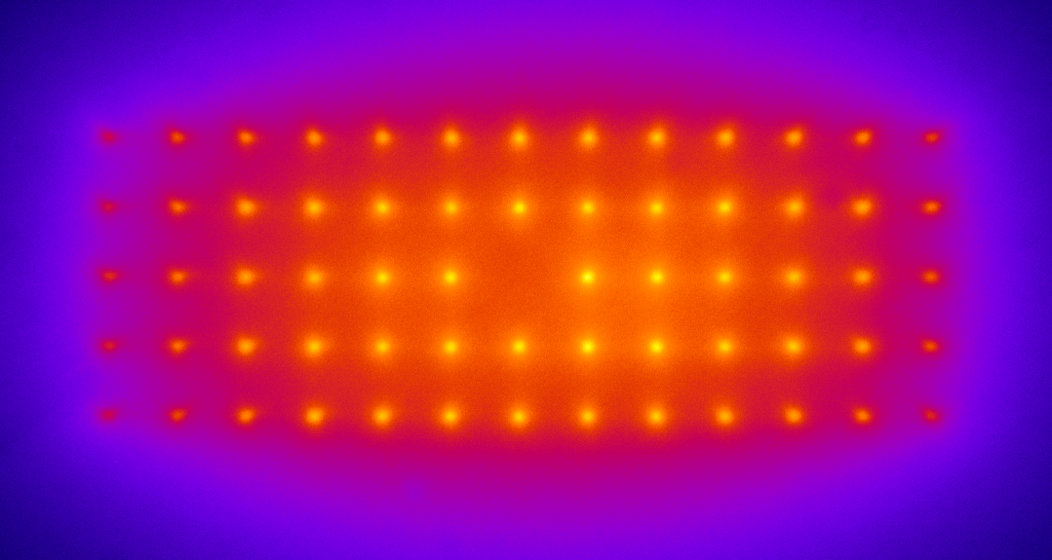
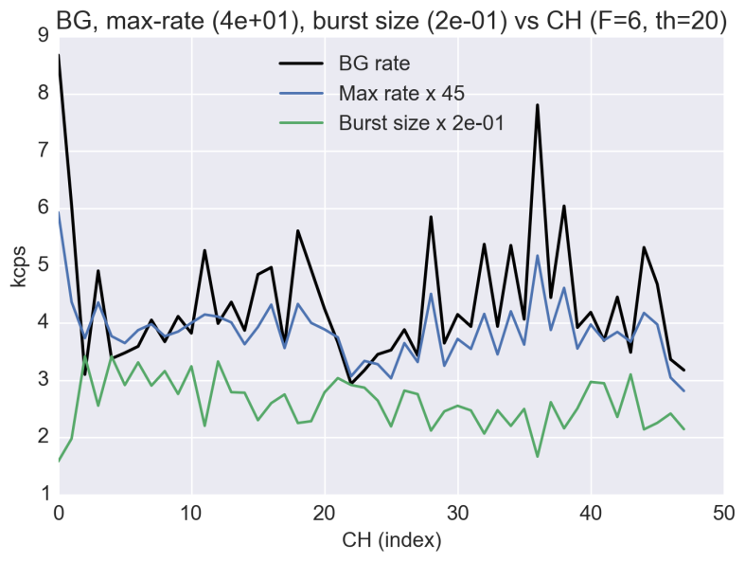
48-spot Single-molecule detection
WeissLab GM May 1st 2014
Antonino Ingargiola

Slide 2
Outline
48-spot single-molecule measurements:
Setup description
Background characterization (space and time)
Saturation study
PSF study

Slide 3
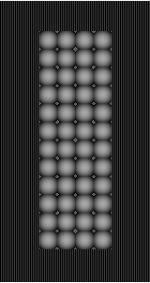
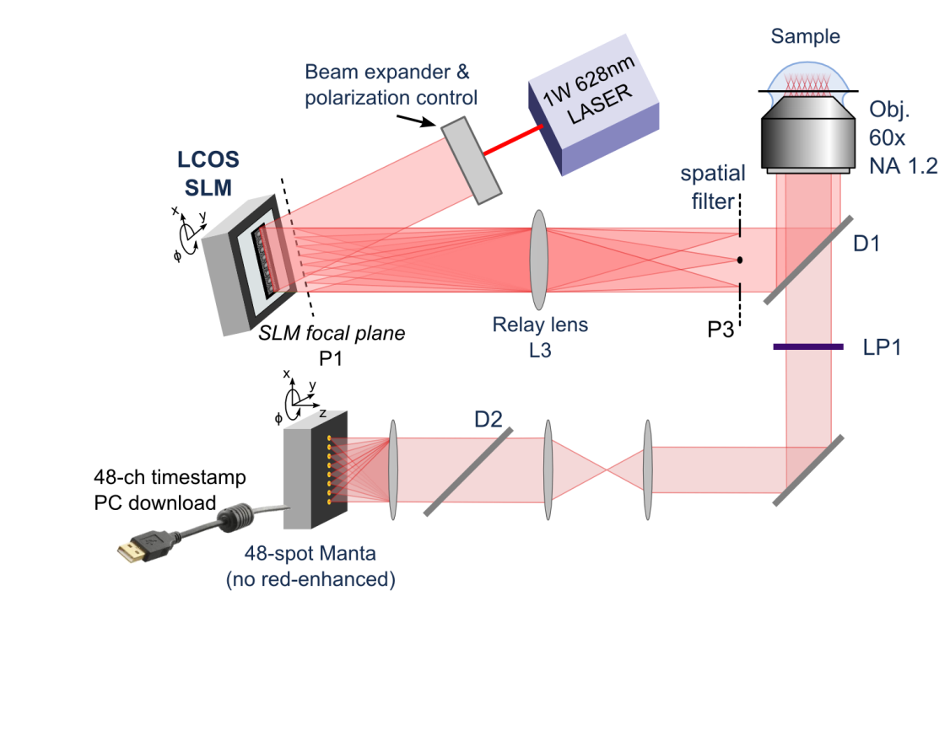
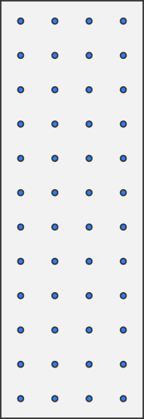
Current 48-spot setup
Sample: doubly-labeled dsDNA ATT0550-ATTO647N,
we can only see the acceptor

Slide 4
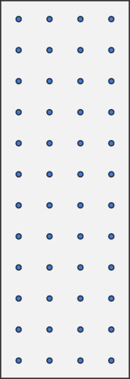
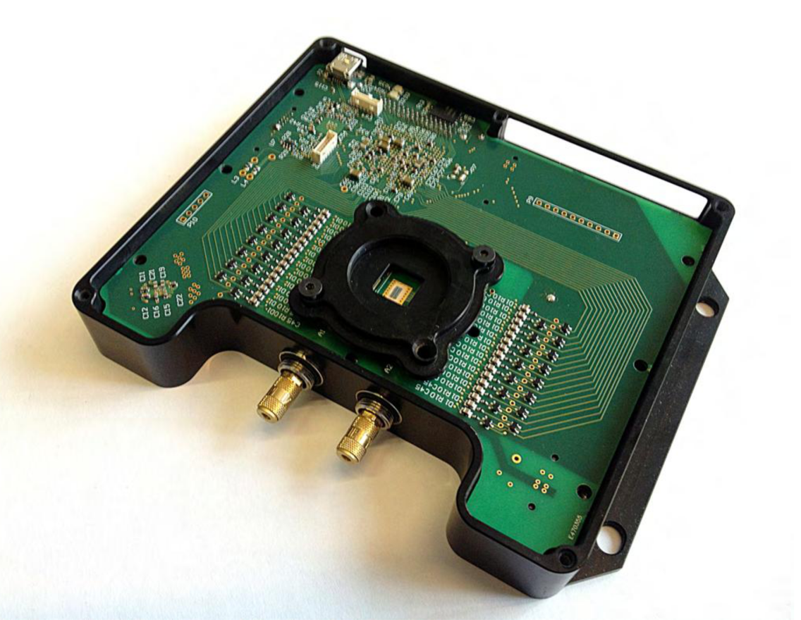
48-pixel Manta Layout
 | 0 | 1 | 2 | 3
0 | 23 | 24 | 25 | 26
1 | 21 | 22 | 27 | 28
2 | 19 | 20 | 29 | 30
3 | 17 | 18 | 31 | 32
4 | 15 | 16 | 33 | 34
5 | 13 | 14 | 35 | 36
6 | 11 | 12 | 37 | 38
7 | 9 | 10 | 39 | 40
8 | 7 | 8 | 41 | 42
9 | 5 | 6 | 43 | 44
10 | 3 | 4 | 45 | 46
11 | 1 | 2 | 47 | 48
Upper section
Center section
Lower section
Pixel diameter 50µm
Pixel pitch 500µm
Geometry 12 x 4

Slide 5
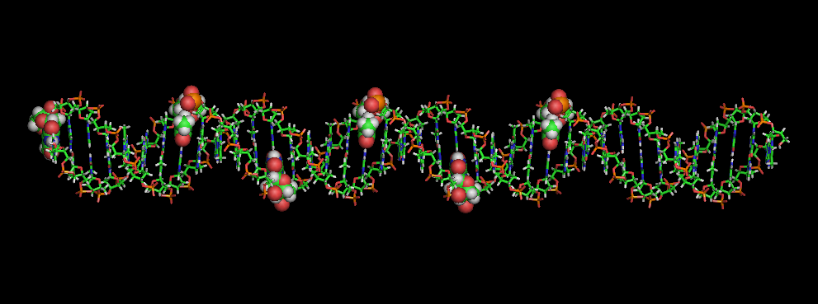
Sample
Acceptor
ATT0647N
Donor ATTO550
40 base-pair
Labels: ATTO647N (acceptor) , ATT0550 (donor)
NHS Ester C6 linker
Dual HPLC purification

Slide 6
Sample
Acceptor
ATT0647N
Donor ATTO550
1 Sample -> 17 bp D-A distance
40 base-pair
Labels: ATTO647N (acceptor) , ATT0550 (donor)
NHS Ester C6 linker
Dual HPLC purification

Slide 7
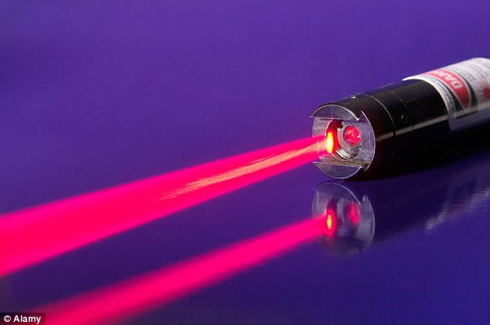
Measurements
Laser powers:
250 mW
400 mW
500 mW
600 mW
750 mW
1000 mW
['/Data/Antonio/data/manta/2014-04-11\\17d_120p_0',
'/Data/Antonio/data/manta/2014-04-11\\17d_200p_1',
'/Data/Antonio/data/manta/2014-04-11\\17d_200p_2_2',
'/Data/Antonio/data/manta/2014-04-11\\17d_200p_2_3',
'/Data/Antonio/data/manta/2014-04-11\\17d_200p_2_4',
'/Data/Antonio/data/manta/2014-04-11\\17d_200p_2_400mW_reall_4',
'/Data/Antonio/data/manta/2014-04-11\\17d_200p_2_500mW_reall_nosteer_5',
'/Data/Antonio/data/manta/2014-04-11\\17d_200p_2_500mW_reall_steer_6',
'/Data/Antonio/data/manta/2014-04-11\\17d_200p_2_750mW_reall_steer_7',
'/Data/Antonio/data/manta/2014-04-11\\17d_200p_2_1000mW_reall_steer_8',
'/Data/Antonio/data/manta/2014-04-11\\17d_200p_2_250mW_reall_steer_9',
'/Data/Antonio/data/manta/2014-04-11\\17d_200p_2_400mW_reall_steer_10',
'/Data/Antonio/data/manta/2014-04-11\\17d_200p_2_600mW_reall_steer_11',
'/Data/Antonio/data/manta/2014-04-11\\17d_200p_2_500mW_reall_steer_12',
'/Data/Antonio/data/manta/2014-04-11\\17d_200p_2_750mW_reall_steer_13',
'/Data/Antonio/data/manta/2014-04-11\\17d_200p_2_1000mW_reall_steer_14',
'/Data/Antonio/data/manta/2014-04-11\\17d_200p_2_1000mW_reall_steer_15',
'/Data/Antonio/data/manta/2014-04-11\\17d_200p_2_250mW_reall_steer_16',
'/Data/Antonio/data/manta/2014-04-11\\17d_200p_2_400mW_reall_steer_17',
'/Data/Antonio/data/manta/2014-04-11\\17d_200p_2_600mW_reall_steer_18',
'/Data/Antonio/data/manta/2014-04-11\\17d_200p_2_500mW_reall_steer_19',
'/Data/Antonio/data/manta/2014-04-11\\17d_200p_2_600mW_reall_steer_20']
No steering pattern
Representative (600mW)

Slide 8
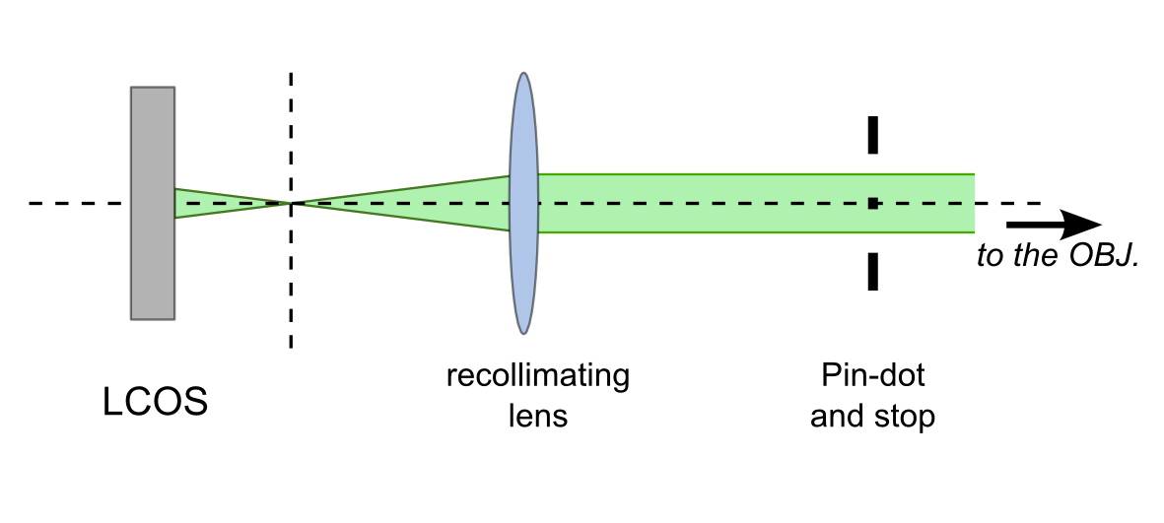
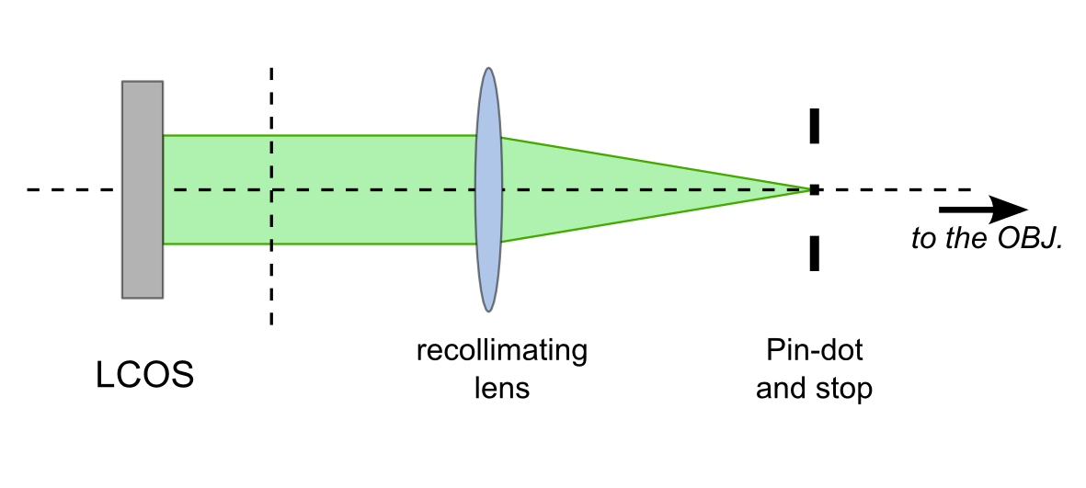
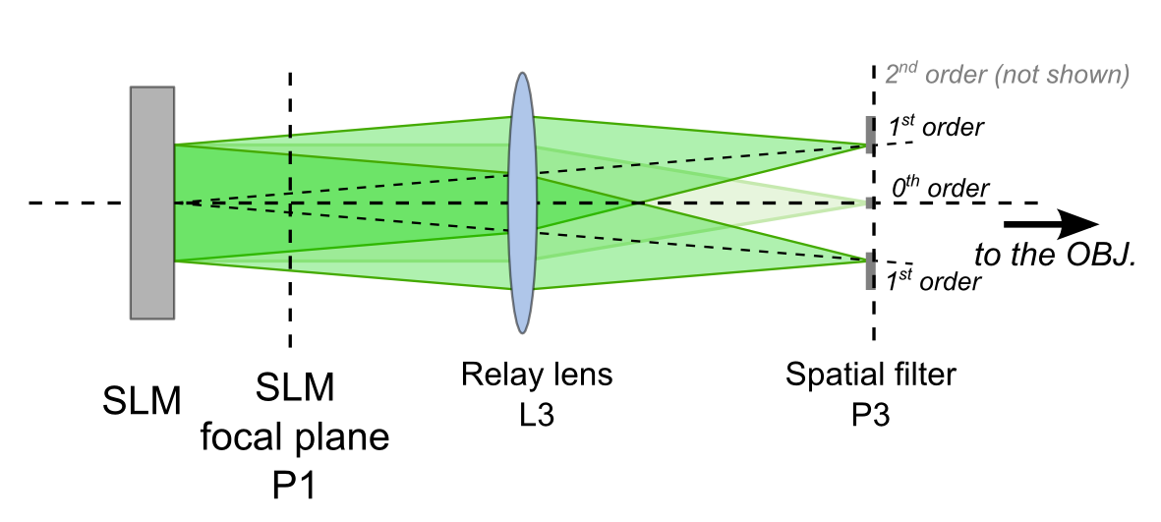
Light modulation … to steer on not to steer?
Modulated light
signal
No beam steering
Unmodulated light
background
Beam steering

Slide 9
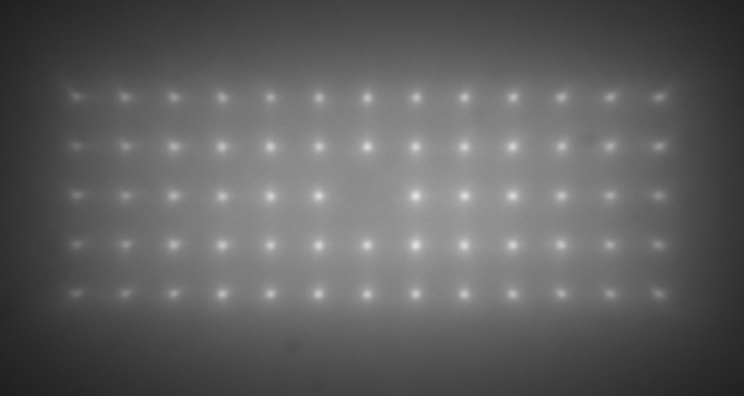
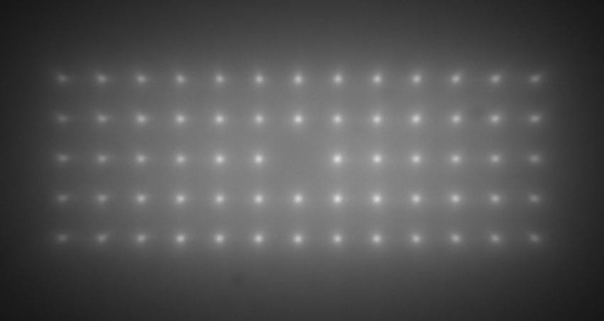
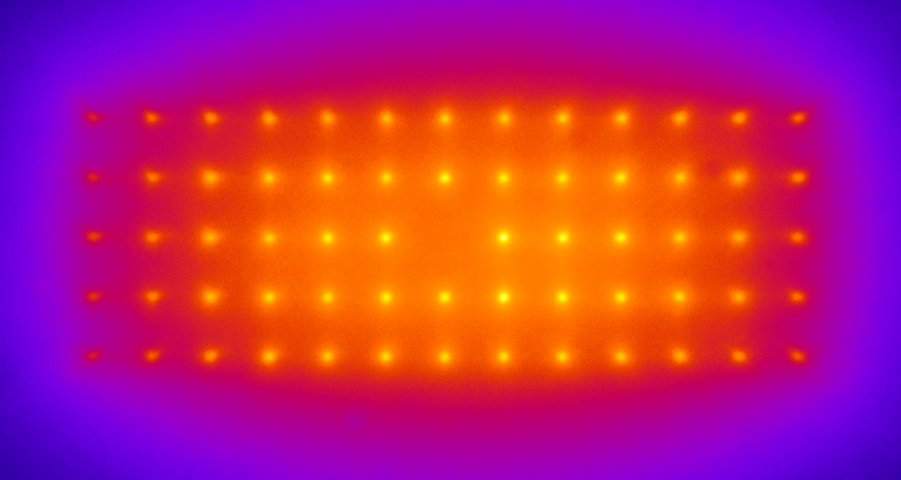
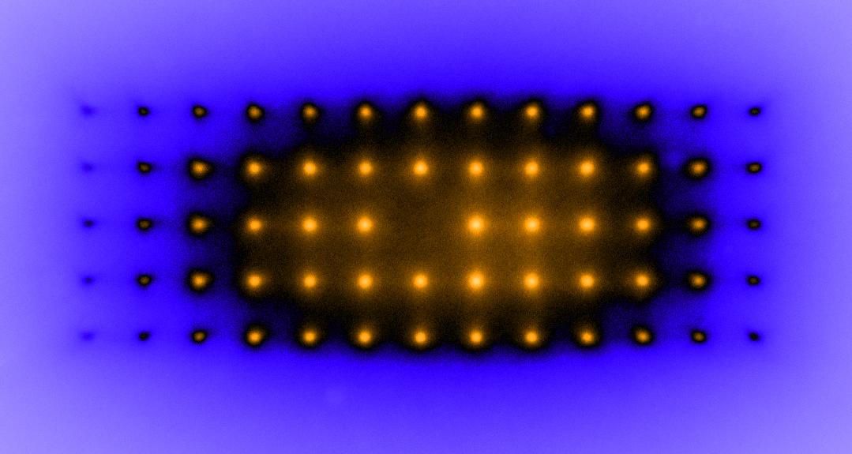
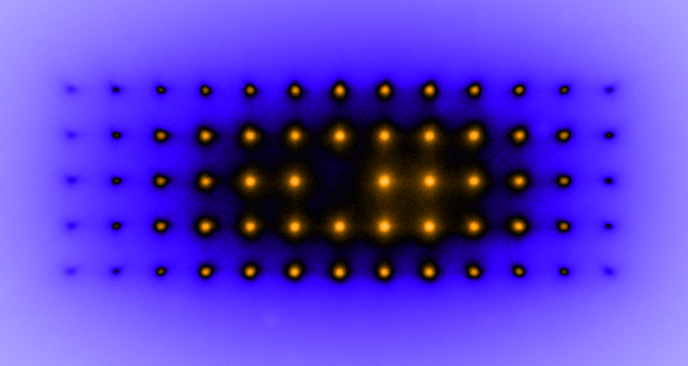
Excitation: 13x5, SPAD pitch
Greys
Fire
ICA
No Steering
Vertical Steering

Slide 10
Results

Slide 11
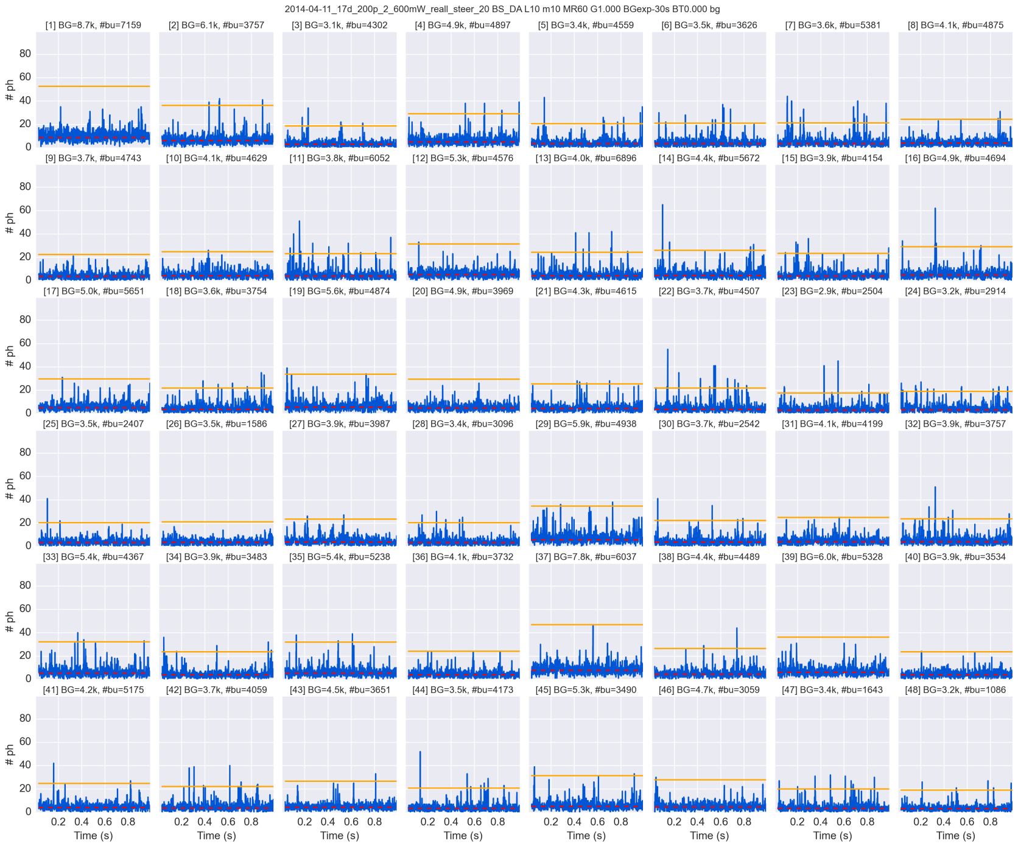
48-spot single-molecule time-trace

Slide 12
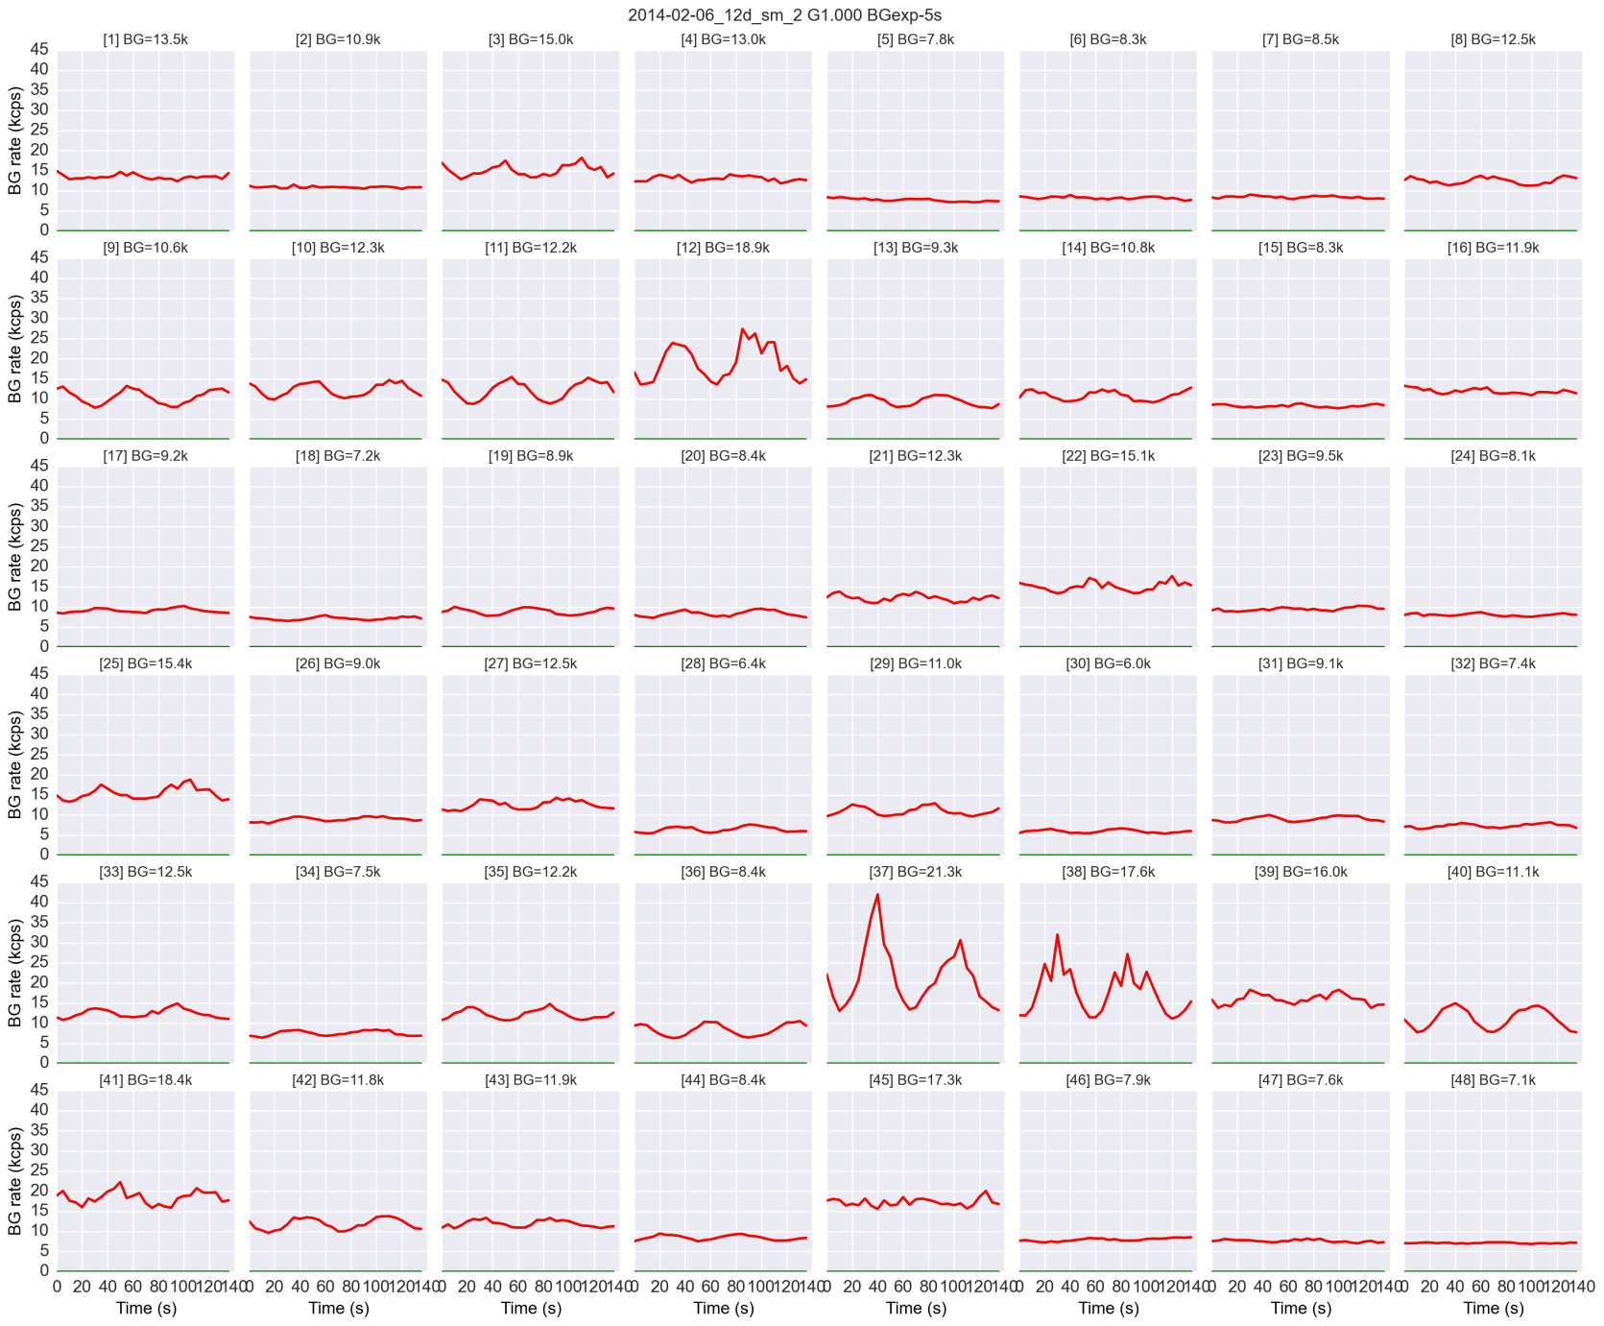
Background vs time (old meas.)

Slide 13
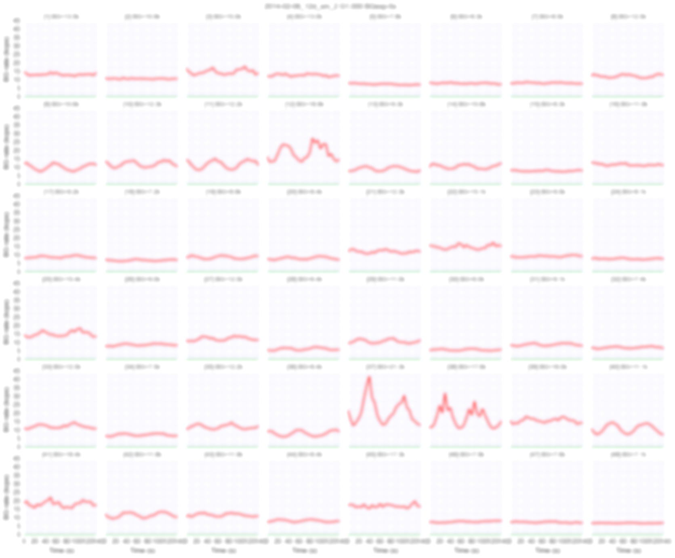
Background vs time (old meas.)
Why?
Thermal drifts
Laser
…

Slide 14
… upgrading some optical components …

Slide 15
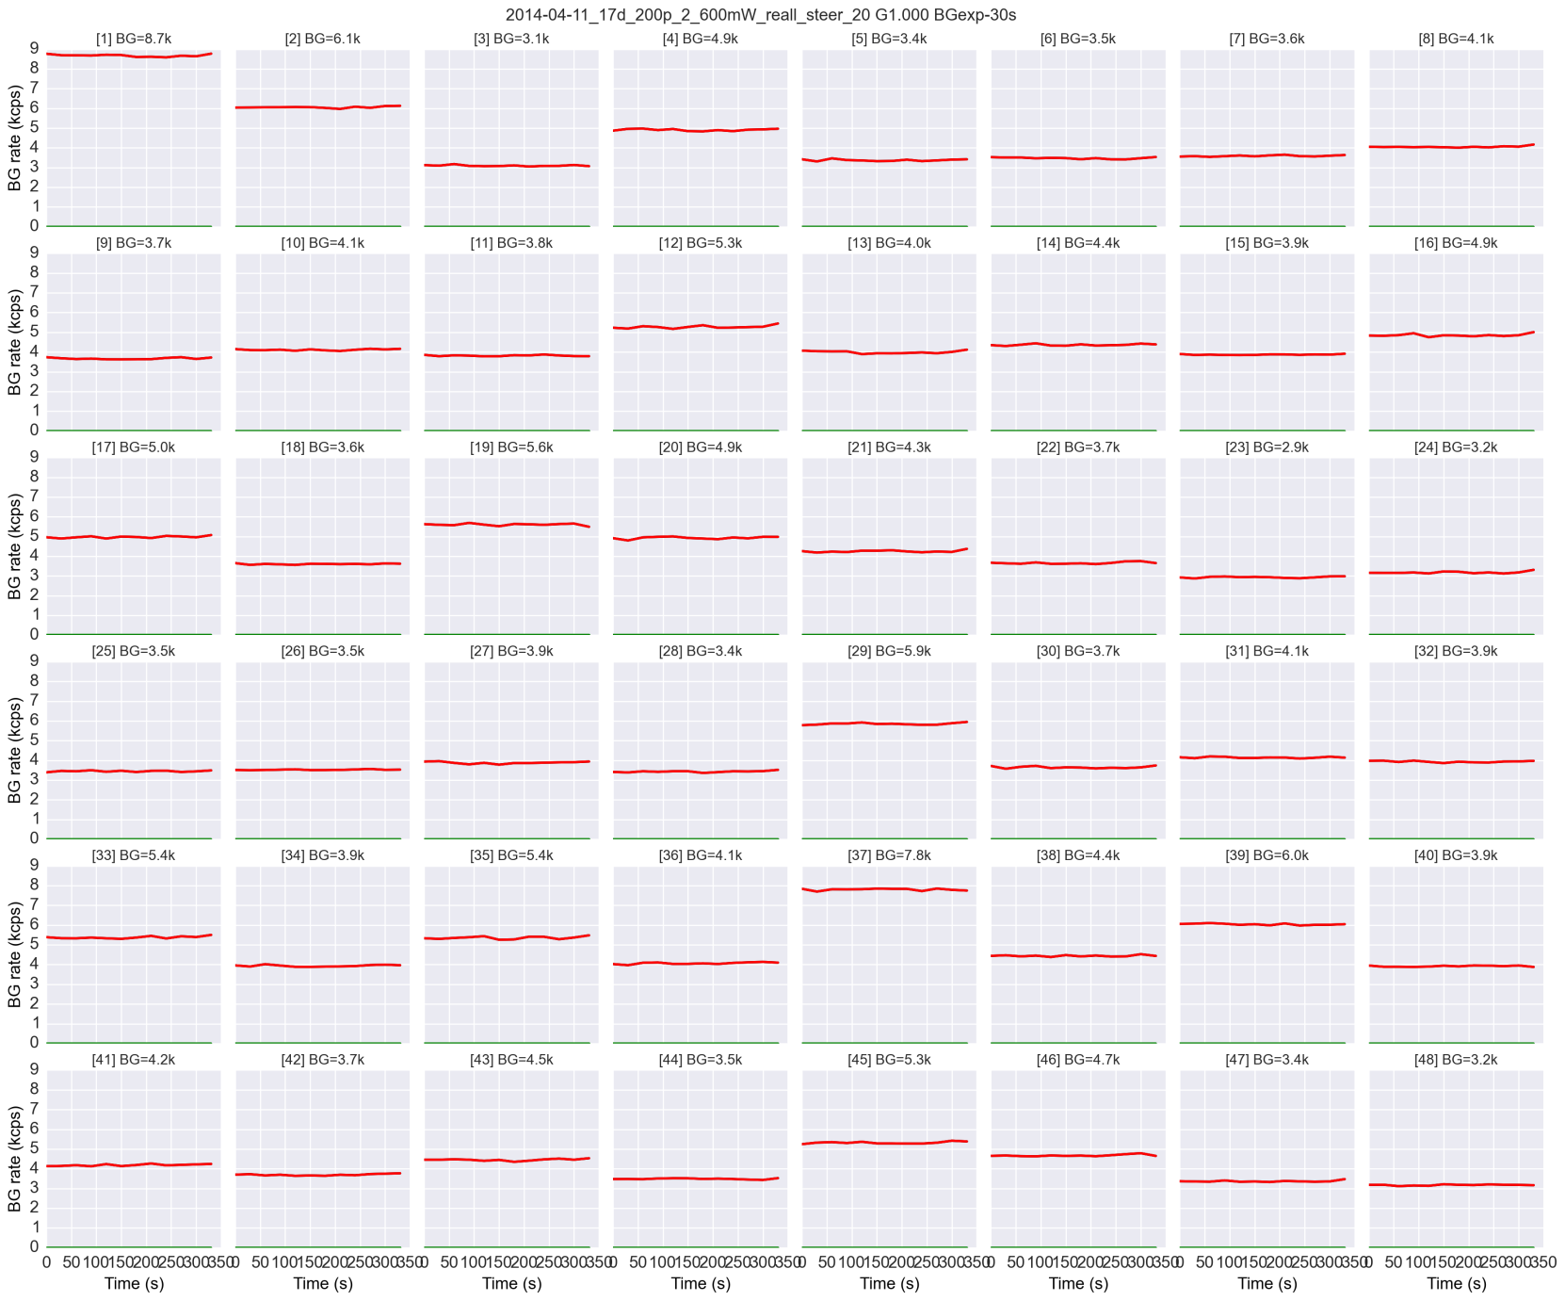
Background vs time (new meas.)

Slide 16
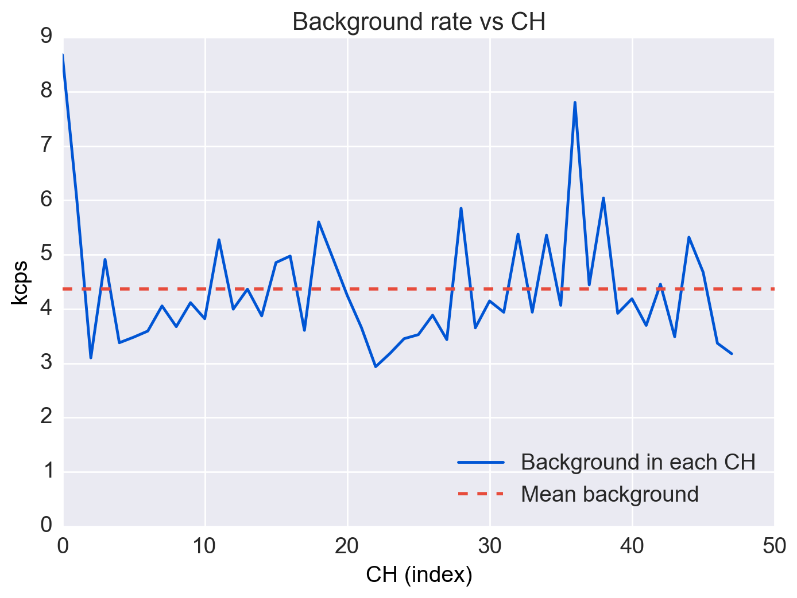
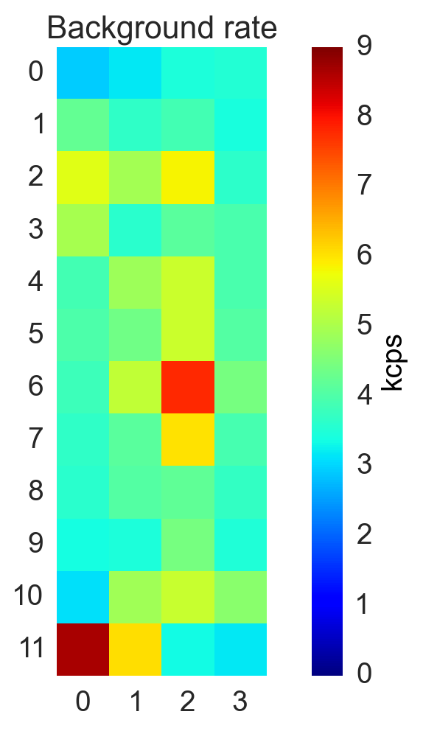

Background
Mean background $\sim$4 kcps @ 600mW
(
)
cps: counts per second
kcps: kilo-counts per second

Slide 17
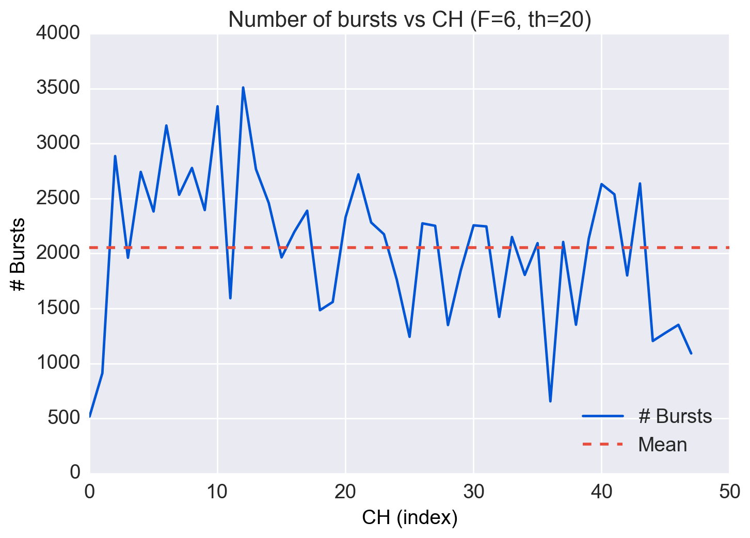
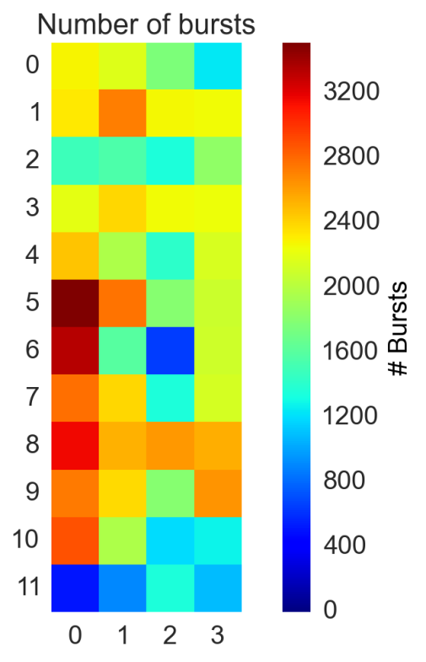
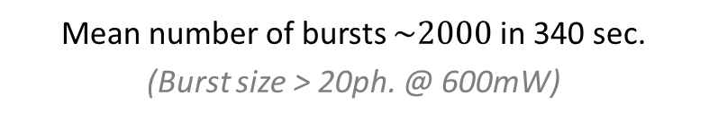
Number of bursts
Mean number of bursts $\sim 2000$ in 340 sec.
(Burst size > 20ph. @ 600mW)

Slide 18
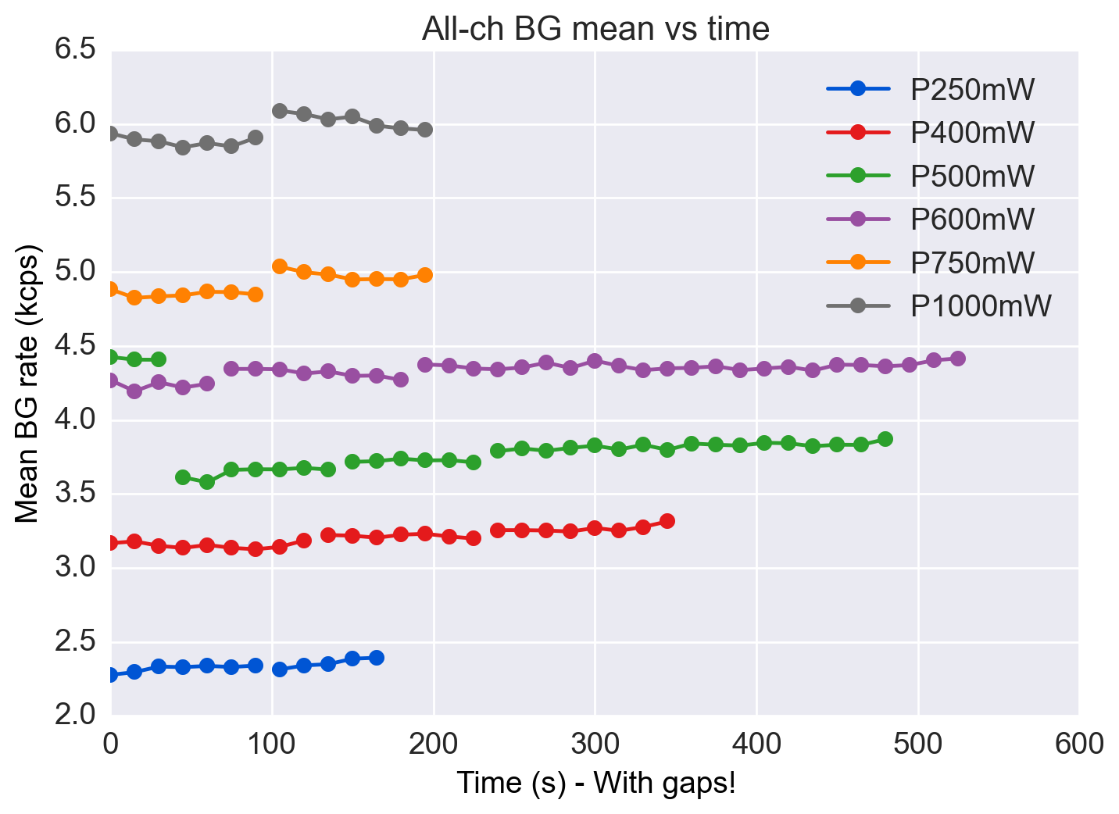
Mean background
Convention:
an interrupted line means a new measurement, but the time gap is not to scale

Slide 19
Mean background
Convention:
an interrupted line means a new measurement, but the time gap is not to scale
Laser power

Slide 20
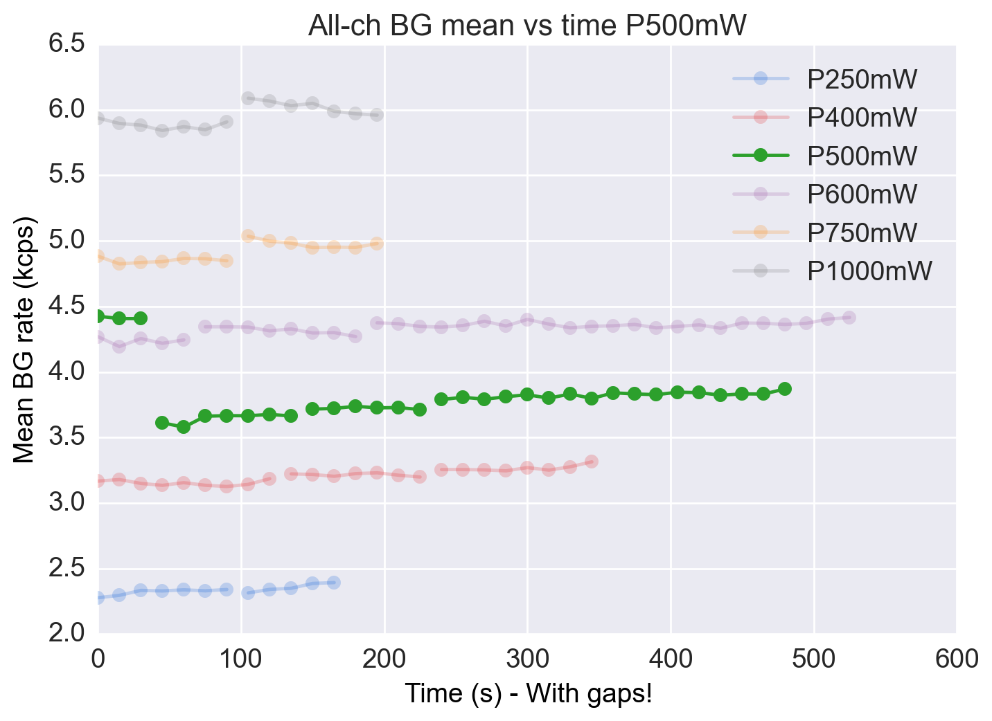
Mean background
Convention:
an interrupted line means a new measurement, but the time gap is not to scale
-25%

Slide 21
Mean background
No beam steering
-25%
with beam steering

Slide 22
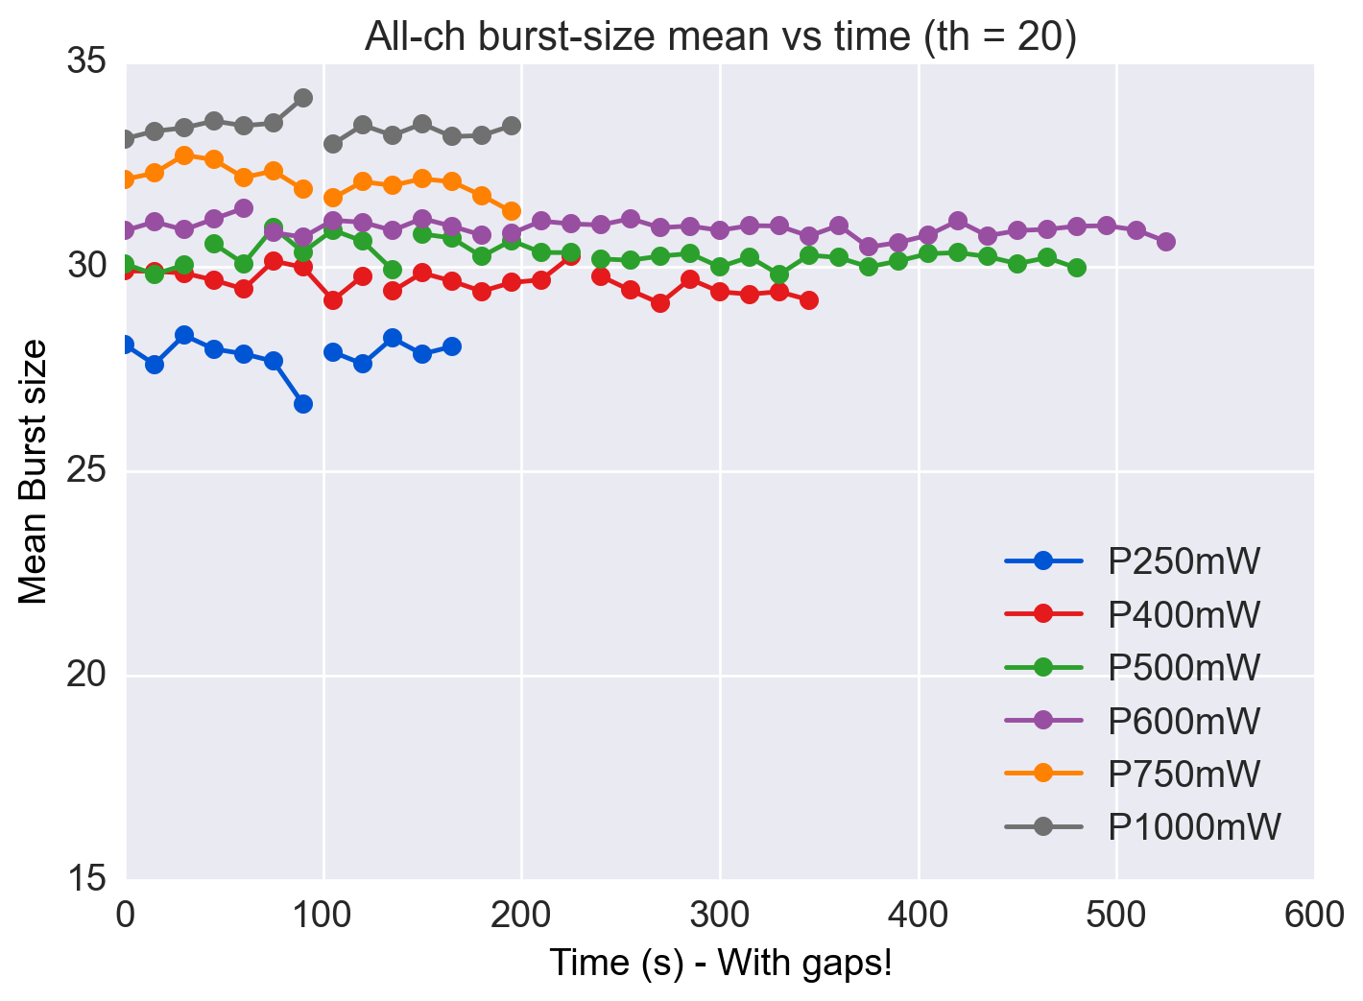
Burst size
The burst size is constant with the laser power

Slide 23
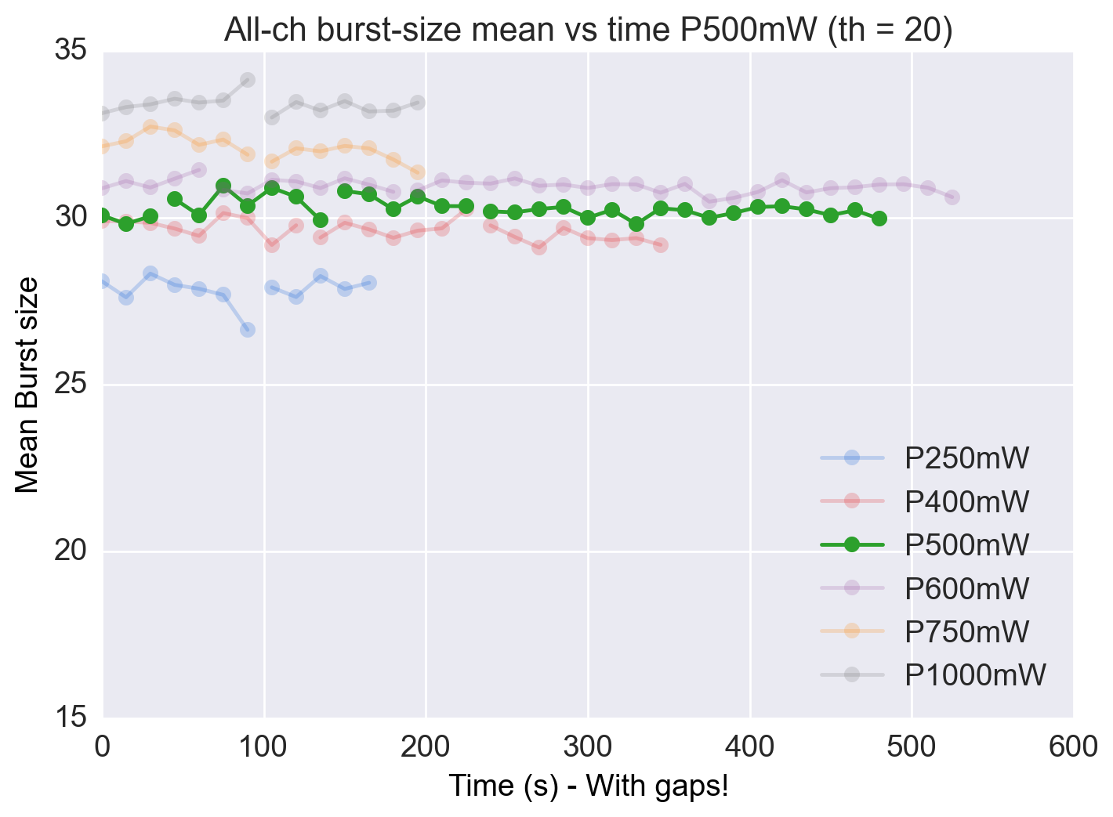
Burst size
No beam steering
with beam steering
Burst size is constant between steering and no steering

Slide 24
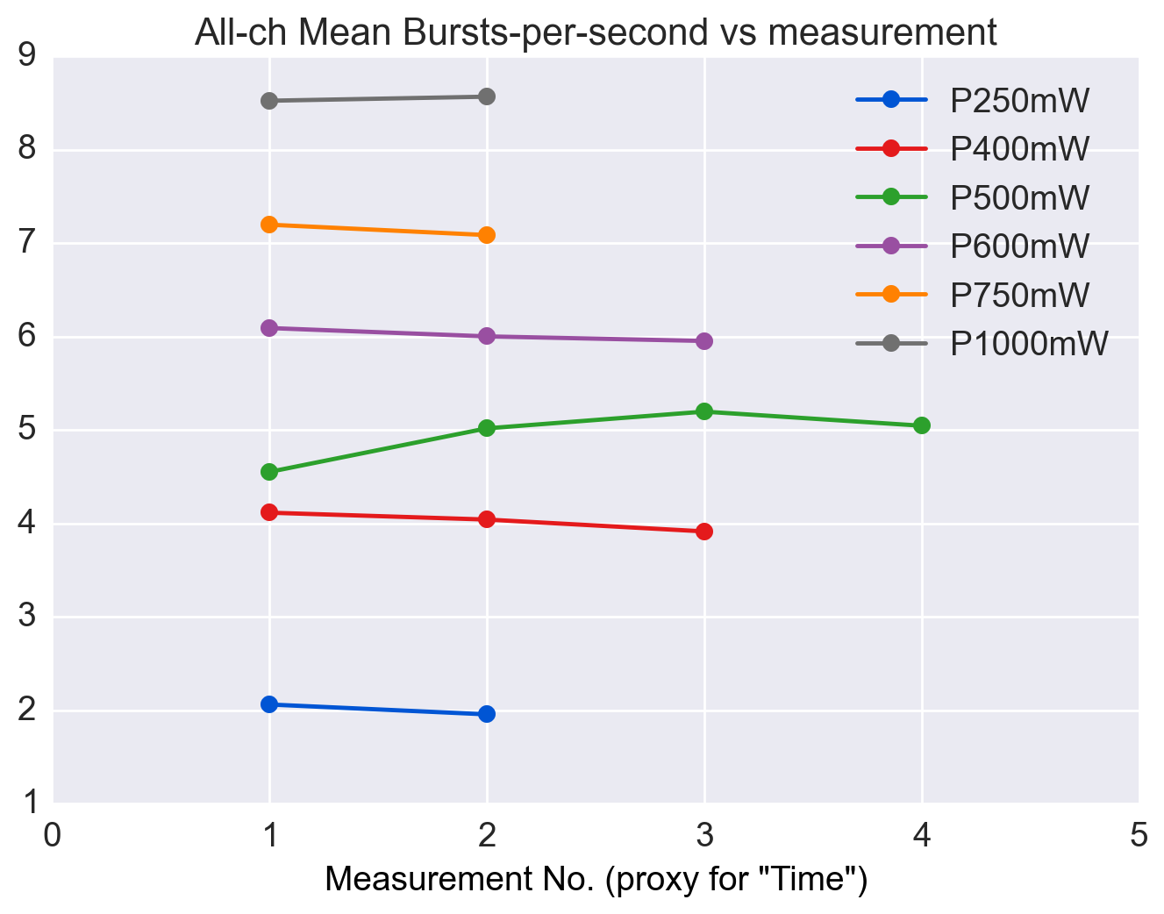
Burst-per-second (bps)
Doesn’t change in time we are not “loosing” (to many) molecules

Slide 25
Remarks
Background does not change with time
Burst size does not change with time
Burst-per-second does not change with time
Steering gives 25% background reduction, in this case
Steering increases the signal-to-background ratio (SBR)

Slide 26
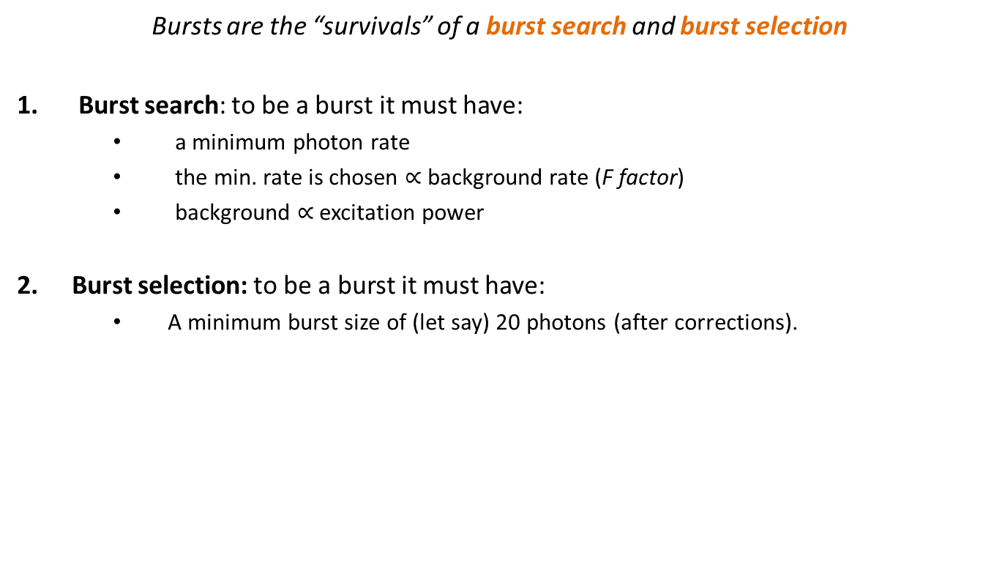
Saturation using the burst size
Bursts are the “survivals” of a burst search and burst selection
Burst search: to be a burst it must have:
a minimum photon rate
the min. rate is chosen $∝$ background rate (F factor)
background $∝$ excitation power
Burst selection: to be a burst it must have:
A minimum burst size of (let say) 20 photons (after corrections).
SBR
Shot-noise
Basic Idea:
bursts are bigger if the emission increases

Slide 27
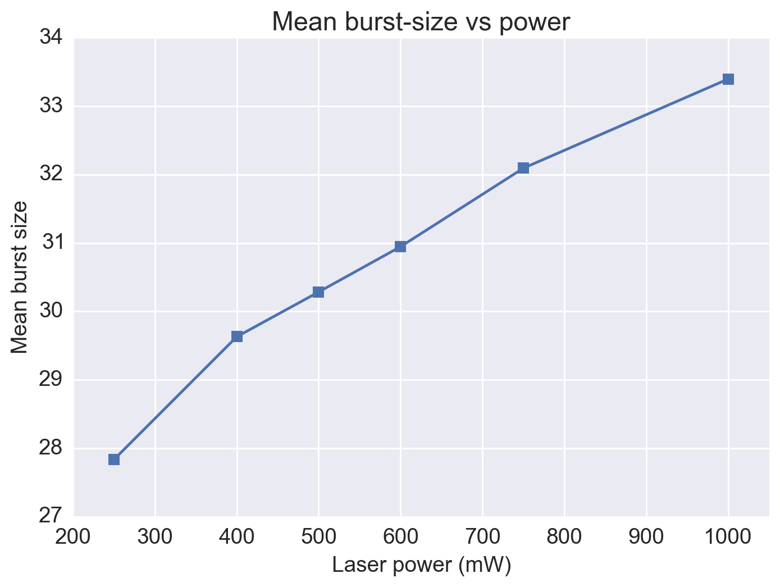
Saturation curve
Q: Does this curve implies we are in saturation or not?

Slide 28
Saturation curve
… seems
quite linear
Q: Does this curve implies we are in saturation or not?

Slide 29
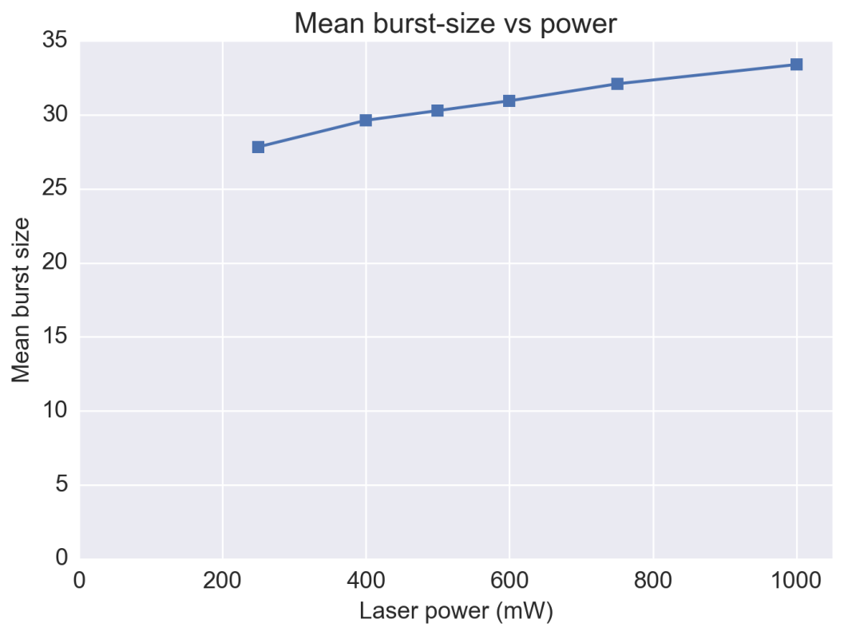
Saturation curve
Q: Does this curve implies we are in saturation or not?

Slide 30
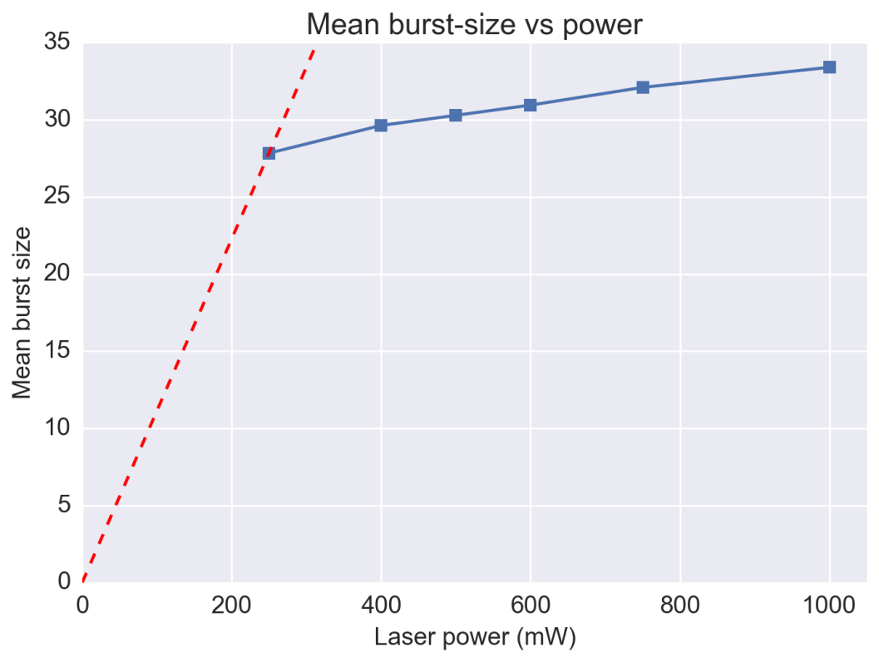
Saturation curve
must be linear
and
passing through
the origin
A: we may be in the strongly saturated regime

Slide 31
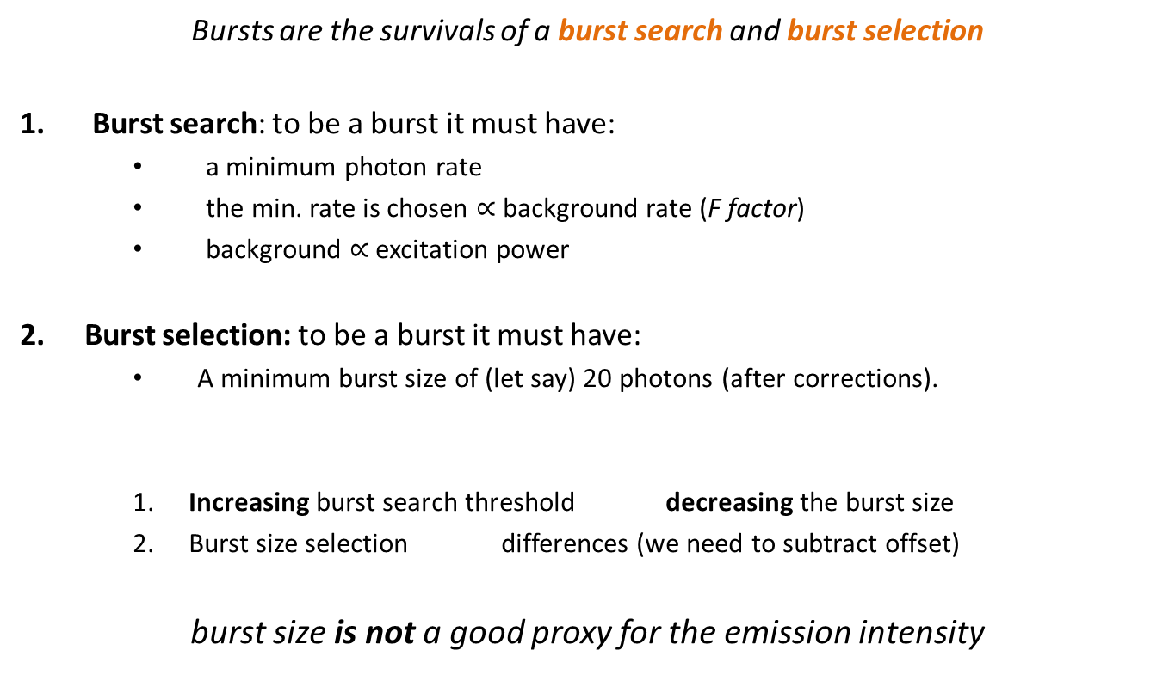
Deep thinking the burst size
Bursts are the survivals of a burst search and burst selection
Burst search: to be a burst it must have:
a minimum photon rate
the min. rate is chosen $∝$ background rate (F factor)
background $∝$ excitation power
Burst selection: to be a burst it must have:
A minimum burst size of (let say) 20 photons (after corrections).
Increasing burst search threshold decreasing the burst size
Burst size selection differences (we need to subtract offset)
burst size is not a good proxy for the emission intensity
SBR
Shot-noise

Slide 32
Saturation curve
must be linear
and
passing through
the origin
A: we may be in the strongly saturated regime

Slide 33
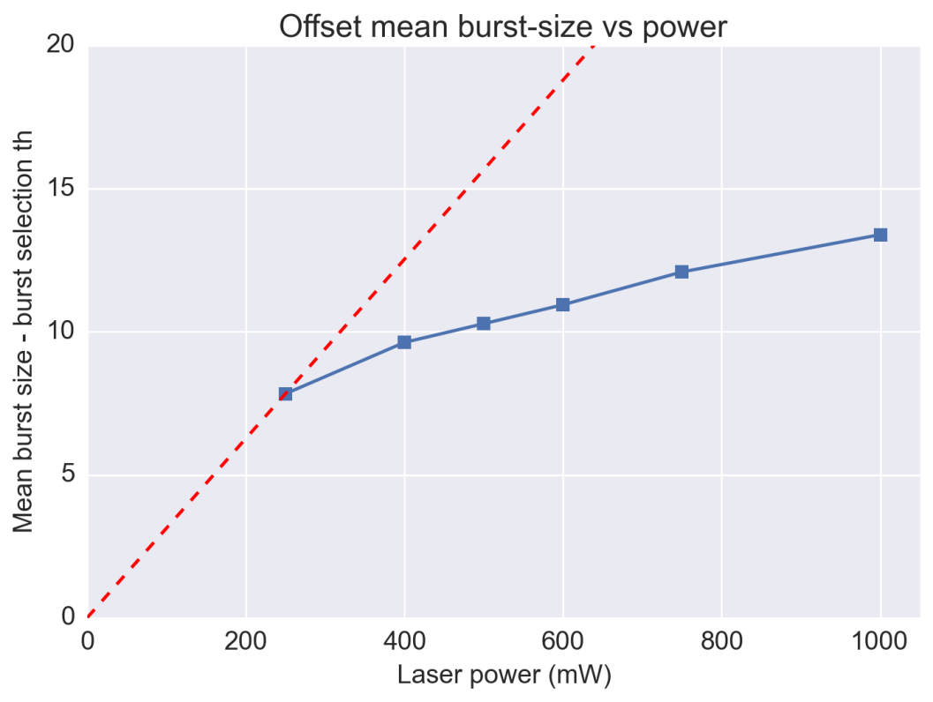
Saturation curve - offset
must be linear
and
passing through
the origin
A: we may be in the strongly saturated regime

Slide 34
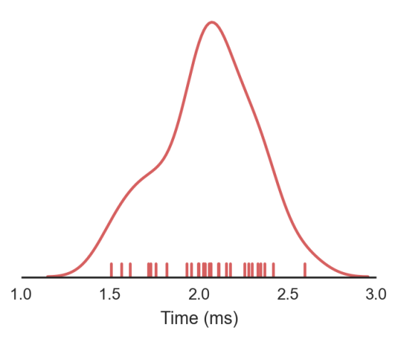
Max. rate in burst
( a.k.a. the tightest m consecutive photons in a burst )
Assumptions
A selected burst has more than m photons (m=10)
We use m photons to compute the rate
Max. rate is
Independent of burst search threshold
Really?
Yes, to the first order. But there is still a slight dependence:
Lower rate thresholds more bursts fused higher mean max rate

Slide 35
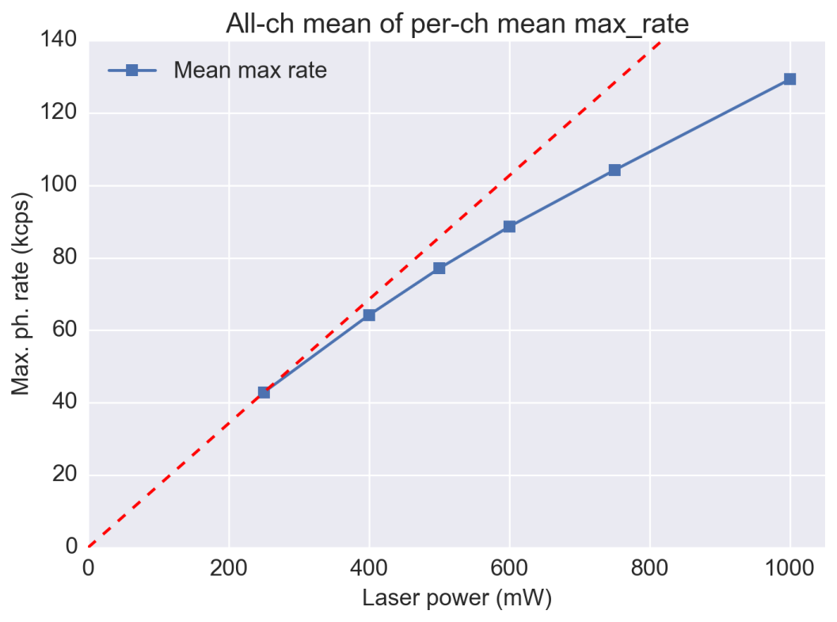
Saturation curve – Max rate
Computational details:
Burst search with F=6, size th. = 20
Joined all measurements at same power
Merged all ch into 1 single ch
Computed per-burst max rate
Computed the mean max rate of each power level
Saturation? Not so much below 500mW

Slide 36
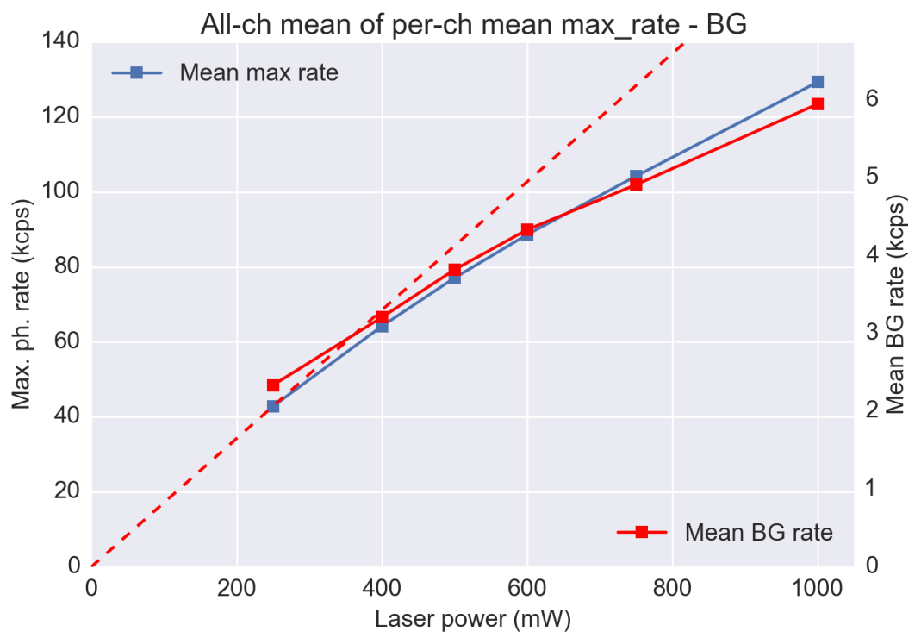
Saturation curve – Background
Computational details:
Burst search with F=6, size th. = 20
Joined all measurements at same power
Merged all ch into 1 single ch
Computed per-burst max rate
Computed the mean max rate of each power level
Saturation? Not so much below 500mW

Slide 37
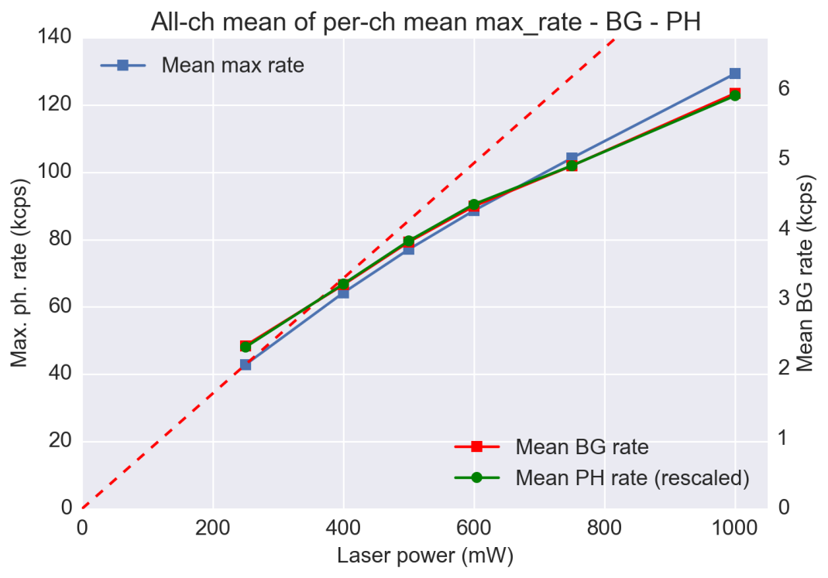
Saturation curve – Background
Computational details:
Burst search with F=6, size th. = 20
Joined all measurements at same power
Merged all ch into 1 single ch
Computed per-burst max rate
Computed the mean max rate of each power level
Saturation? Not so much below 500mW

Slide 38
Open issues
In principle
Saturation happens at high intensity in the spot “core”
Should not be visible in the background because of the lower intensity
We should have “more” saturation in the brightest spots
Experimentally:
Photon rates and BG have the exact same dependence on power
This means that the “signal” increases as much as the background, indicating no saturation
Also
Subtracting the background is difficult because the max_rate tend to select the background highest tail
Let look at groups of pixels or single-pixels

Slide 39

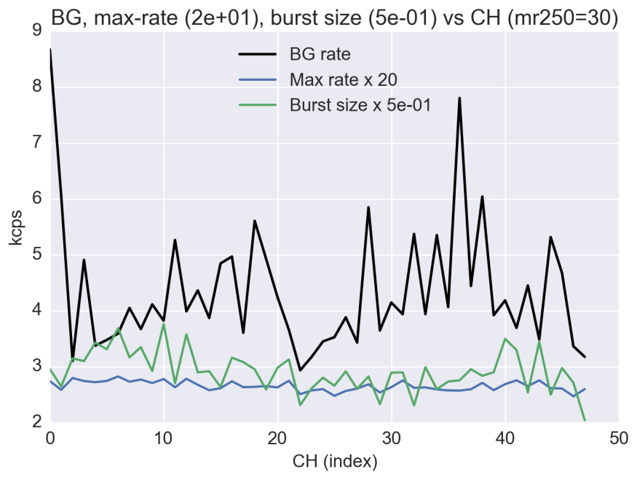
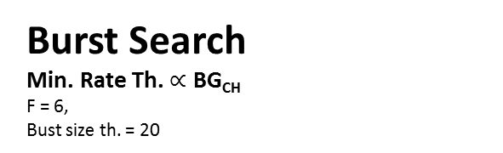
Correlation with BG
Burst Search
Min. Rate Th. $∝$ BG_{CH}
F = 6,
Bust size th. = 20
Burst Search
Min. Rate Th. = const . scales with: Mean( BG_{CH} )
min_rate = const., th=20
min_rate_250mW = 30 kcps
min_rate_XmW = min_rate_250mW * (bg_X/bg_250mW)

Slide 40
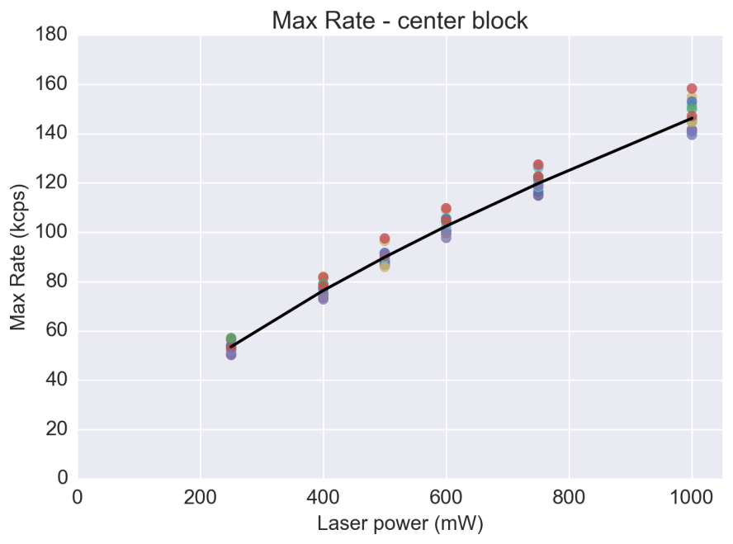
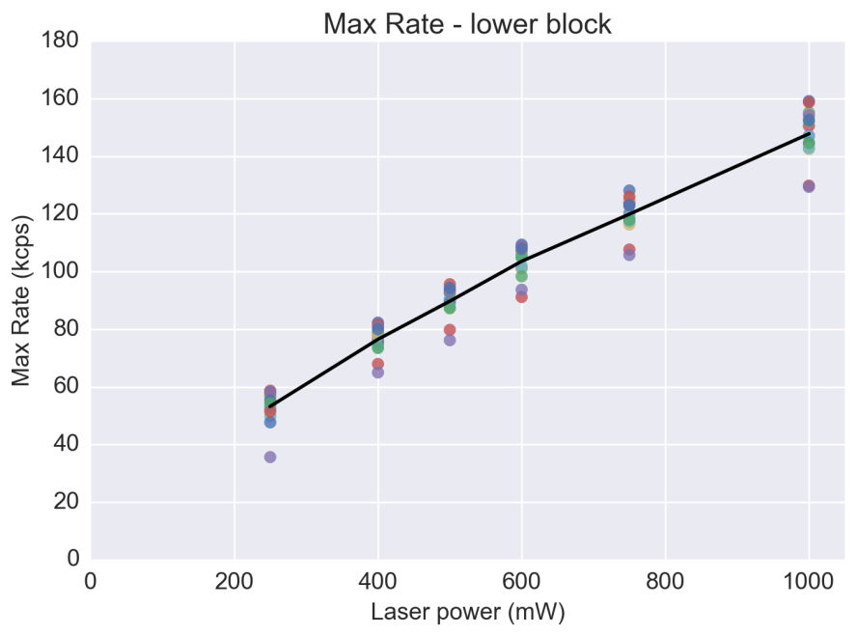
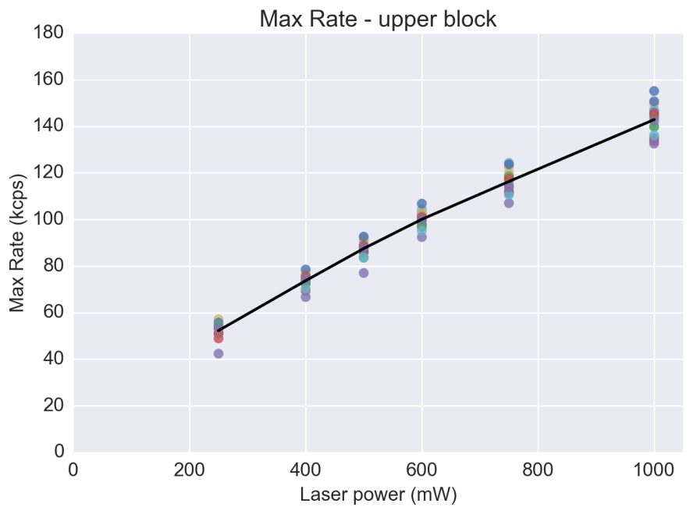
Min. rate @ 250mW = 20kcps

Slide 41
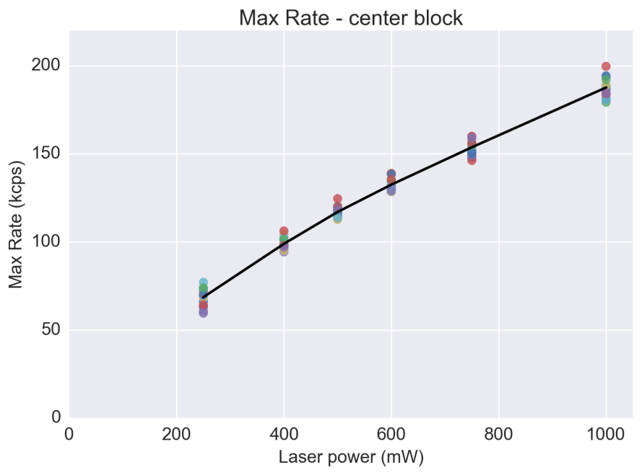
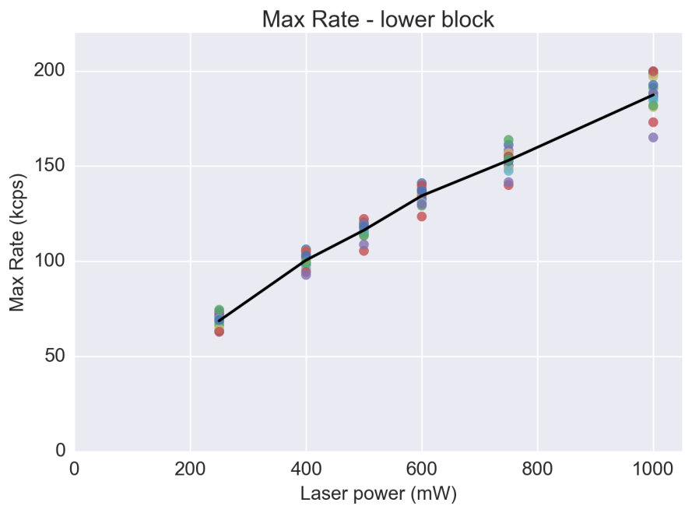
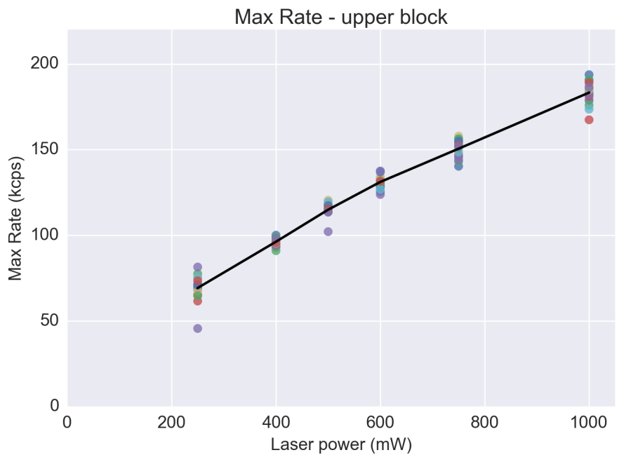
Min. rate @ 250mW = 30kcps

Slide 42



Min. rate @ 250mW = 40kcps

Slide 43



Min. rate @ 250mW = 50kcps

Slide 44



Saturation in pixel groups
Burst Search
Min. Rate Th. $∝$ BG_{CH}
F = 6,
Bust size th. = 20
Burst Search
Min. Rate Th. = const . scales with: Mean( BG_{CH} )
min_rate = const., th=20
min_rate_250mW = 30 kcps
min_rate_XmW = min_rate_250mW * (bg_X/bg_250mW)
CH

Slide 45

Saturation in pixel groups
Linear but the rate is too uniform!!
Burst Search
Min. Rate Th. = const . scales with P_{LASER}
min_rate = const., th=20
min_rate_250mW = 25 kcps
min_rate_XmW = min_rate_250mW *
( P(X mW) / P(250 mW) )
Burst Search
Min. Rate Th. = const . scales with Mean( BG_{CH} )
min_rate = const., th=20
min_rate_250mW = 30 kcps
min_rate_XmW = min_rate_250mW * (bg_X/bg_250mW)
CH

Slide 46

Refine the burst search
We used
Constant minimum ph. rate threshold for all the CH
But
Different spot have different intensity so different photon rate distribution
Therefore
We clip different distribution with the same threshold and we take the mean
The mean max_rate is not $∝$ emission
Idea
Selecting only the top N bursts we clip each CH distribution @ “equivalent” points

Slide 47






Truncated distributions
Aim: Calculate the ratio of the means
Example: Poisson distribution
Distribution mean
$$λ_{1}=\int{x f_{1}(x)} dx$$
$$f_{1}$$
$$λ_{2}=\int{x f_{2}(x)} dx$$
$$f_{2}$$
$$\frac{λ_{2}}{λ_{1}}=2$$

Slide 48





Truncated distributions
Aim: Calculate the ratio of the means
Example: Poisson distribution
Distribution mean
$$λ_{1}=\int{x f_{1}(x)} dx$$
$$f_{1}$$
$$λ_{2}=\int{x f_{1}(x)} dx$$
$$f_{2}$$
Truncated distribution mean
$$I_{1}=\int_{th}^{∞}{x f_{1}(x)} dx$$
$$I_{2}=\int_{th}^{∞}{x f_{2}(x)} dx$$
$$\frac{λ_{2}}{λ_{1}}=2$$
$$\frac{I_{2}}{I_{1}}=5≠\frac{λ_{2}}{λ_{1}}$$

Slide 49




Truncated distributions
Aim: Calculate the ratio of the means
Example: Poisson distribution
Distribution mean
$$λ_{1}=\int{x f_{1}(x)} dx$$
$$f_{1}$$
$$λ_{2}=\int{x f_{2}(x)} dx$$
$$f_{2}$$
Truncated distribution mean
$$I_{1}=\int_{th1}^{∞}{x f_{1}(x)} dx$$
$$I_{2}=\int_{th2}^{∞}{x f_{2}(x)} dx$$
$$\frac{λ_{2}}{λ_{1}}=2$$
$$\frac{I_{2}}{I_{1}}=2.1≈\frac{λ_{2}}{λ_{1}}$$
(is not exactly 2 because of discretization)

Slide 50







Truncated distributions
Aim: Calculate the ratio of the means
Distribution mean
Simulation: Erlang distribution
$$λ_{1}=\int{x f_{1}(x)} dx$$
$$f_{1}$$
$$λ_{2}=\int{x f_{2}(x)} dx$$
$$f_{2}$$
Truncated distribution mean
$$I_{1}=\int_{th1}^{∞}{x f_{1}(x)} dx$$
$$I_{2}=\int_{th2}^{∞}{x f_{2}(x)} dx$$
Simulation
Form each distribution:
Draw 3000 samples
Selected the top 1000
$$\frac{λ_{2}}{λ_{1}}=2$$
$$\frac{I_{2}}{I_{1}}=2.04≈\frac{λ_{2}}{λ_{1}}$$

Slide 51
Burst search
Thresholding is equivalent of truncating the distribution
Thresholding is necessary to separate the background (another distribution)
Selecting the top N bursts we sample a fixed “fraction” of the distribution
Applying the concept to the burst max_rate we can sample the emission intensity peak
Once we know the peak we can compute the PSF FWHM using the burst duration

Slide 52


In-burst max-rate
Rationale
The peak count-rate in each bursts $∝$ excitation
Sampling the “biggest” N bursts:
we select trajectories that cross the PSF peak
analogous trajectories in all the CH, irrespective of the PSF intensity
Average across the bursts to smooth the statistical noise
Algorithm
Burst search with Min. Rate Th. = constant
Avoid background influence
Select top N bursts
Bursts with highest rate
Compute mean(max_rate) for each channel
Average the max_rate of each burst
Result
a measure of the PSF peak intensity
DOES NOT depends on the burst-search threshold
DOES depends on the spot peak intensity

Slide 53


Per-pixel saturation curve
Burst Search
Min. Rate Th. = constant, scales with P_{LASER}
min_rate = const.
min_rate_250mW = 25 kcps
min_rate_XmW = min_rate_250mW * ( P(X mW) / P(250 mW) )
Select top N bursts (3 bps)
Compute: mean(Max_Rate)

Slide 54
Per-pixel saturation curve
 | 0 | 1 | 2 | 3
0 | 23 | 24 | 25 | 26
1 | 21 | 22 | 27 | 28
2 | 19 | 20 | 29 | 30
3 | 17 | 18 | 31 | 32
4 | 15 | 16 | 33 | 34
5 | 13 | 14 | 35 | 36
6 | 11 | 12 | 37 | 38
7 | 9 | 10 | 39 | 40
8 | 7 | 8 | 41 | 42
9 | 5 | 6 | 43 | 44
10 | 3 | 4 | 45 | 46
11 | 1 | 2 | 47 | 48
Upper section
Center section
Burst Search
Min. Rate Th. = constant, scales with P_{LASER}
min_rate = const.
min_rate_250mW = 25 kcps
min_rate_XmW = min_rate_250mW * ( P(X mW) / P(250 mW) )
Select top N bursts (3 bps)
Compute: mean(Max_Rate)
Lower section

Slide 55




Saturation curve – pixels groups

Slide 56

PSF characterization
We can estimate the PSF peak intensity
(mean of top N max_rate)
We can set a burst-search threshold @ 50% of peak
The burst duration becomes $∝$ to the PSF FWHM

Slide 57
48-pixel Manta Layout
 | 0 | 1 | 2 | 3
0 | 23 | 24 | 25 | 26
1 | 21 | 22 | 27 | 28
2 | 19 | 20 | 29 | 30
3 | 17 | 18 | 31 | 32
4 | 15 | 16 | 33 | 34
5 | 13 | 14 | 35 | 36
6 | 11 | 12 | 37 | 38
7 | 9 | 10 | 39 | 40
8 | 7 | 8 | 41 | 42
9 | 5 | 6 | 43 | 44
10 | 3 | 4 | 45 | 46
11 | 1 | 2 | 47 | 48
Upper section
Center section
Lower section

Slide 58

Max rate distribution

Slide 59

Max rate distribution: top 800 bursts

Slide 60

Number of bursts
The # bursts becomes independent from the spot intensity

Slide 61

PSF Peak intensity

Slide 62









PSF width
$$σ$$
$$σ$$
$$d_{1}$$
$$d_{2}$$
$$d_{1}>d_{2}$$

Slide 63


PSF width
anticorrelation
$$d_{2}$$
$$d_{1}$$
$$d_{1}>d_{2}$$

Slide 64


Burst size
Open question
Why is the burst size so constant?

Slide 65
Thank you!

Slide 66








Burst searches comparison
Burst Search
Th $∝$ BG
F=6
Size Th=20
Burst Search
Th fixed
Min rate @ 250mW = 25kcps
Min rate scales with laser power
Size Th=20

